Slide 1
ME469: Residual-based Advection Stabilization
Stefan P. Domino^{1,2}
¹ Computational Thermal and Fluid Mechanics, Sandia National Laboratories
² Institute for Computational and Mathematical Engineering, Stanford
SAND2018-4536 PE

Slide 2
Review of Advection Stabilization Options
For the high Peclet number use case, on unstructured meshes, we have identified three strategies:
Ad hoc blending between upwind and central using an indicator that is a function of cell Peclet number:
Gradient reconstruction (upwind) approaches with limiters
Monotonic upstream-centered scheme for conservation laws (MUSCL) - again, with limiters

Slide 3
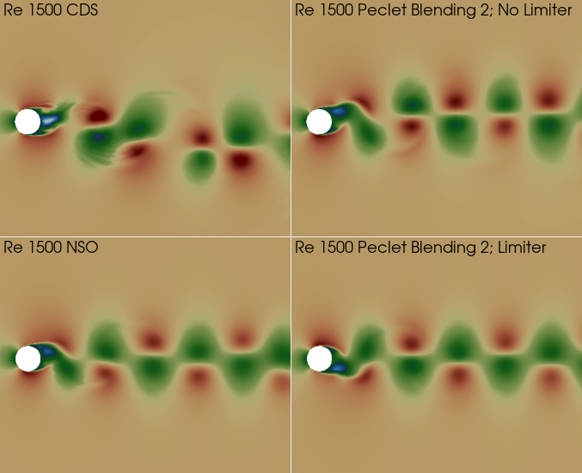
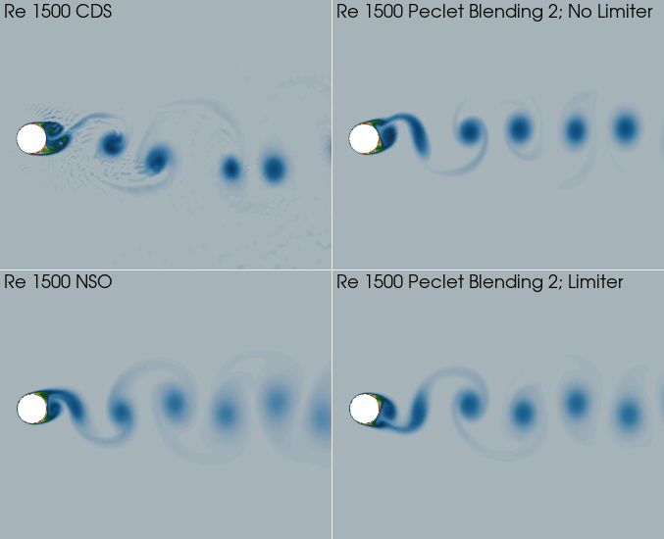
Momentum Field is Tolerant of low-Dissipation Advection Operators
…. While passive scalars are not

Slide 4
Re = 2000 (local Re 20) – No Stabilization
Analytical solution from Mojtabi and Deville, One-dimensional linear advection–diffusion equation: Analytical and finite element solutions, Comput. Fluids 107 (2015) 189–195.
Linear Basis (CVFEM), central/Galerkin
Quadratic Basis (CVFEM), central/Galerkin

Slide 5
Re = 2000 (local Re 20) – Upwind
Analytical solution from Mojtabi and Deville, One-dimensional linear advection–diffusion equation: Analytical and finite element solutions, Comput. Fluids 107 (2015) 189–195.
First-order upwind
Second-order upwind
Second-order upwind + limiter

Slide 6
Recall a Strategy: Central + Diffusion
A general advection system can be written in terms of a central-based scheme and a diffusion term using an effective viscosity
The goals are to be:
Consistent, i.e., as you refine the mesh, you revert to the desired PDE
Design-order, i.e., converges as Δx^{p+1}
Simply re-casting a first-order upwind scheme
Lax-Wendroff, System of
Conservation Laws, LA-2285 (1960)
Similar to Taylor-Galerkin

Slide 7
Residual Definition
On a given mesh, h, if we were to evaluate the residual, what would we obtain?
As we refine the mesh, the evaluation of this “fine-scale” residual would approach zero – at least for a consistent discretization approach whose truncation error is well-behaved
A classic residual-based stabilization, Streamwise Upwind Petrov-Galerkin (Hughes and Brooks, 1982) – more generalized within the Variational Multiscale Method (VMS, Hughes et. al, 1998)
Element-metrics
β ~ 1; c ~ O(10)

Slide 8
SUPG Stabilization in a Finite Volume Context
Finite Element Context:
Finite Volume Context by applying the piecewise constant test function:
Assuming we have a design-order representation of the residual, the method is consistent
With:
Note: Godunuv’s theorem states that a
linear stabilization approach is not
sufficient to damp out all oscillations

Slide 9
SUPG Stabilization in a Finite Volume Context
Finite Element Context:
Finite Volume Context by applying the piecewise constant test function:
Assuming we have a design-order representation of the residual, the method is consistent
Note: Diffusion terms, a second-order derivative require special care (projection)
With:
Note: Godunuv’s theorem states that a
linear stabilization approach is not
sufficient to damp out all oscillations

Slide 10
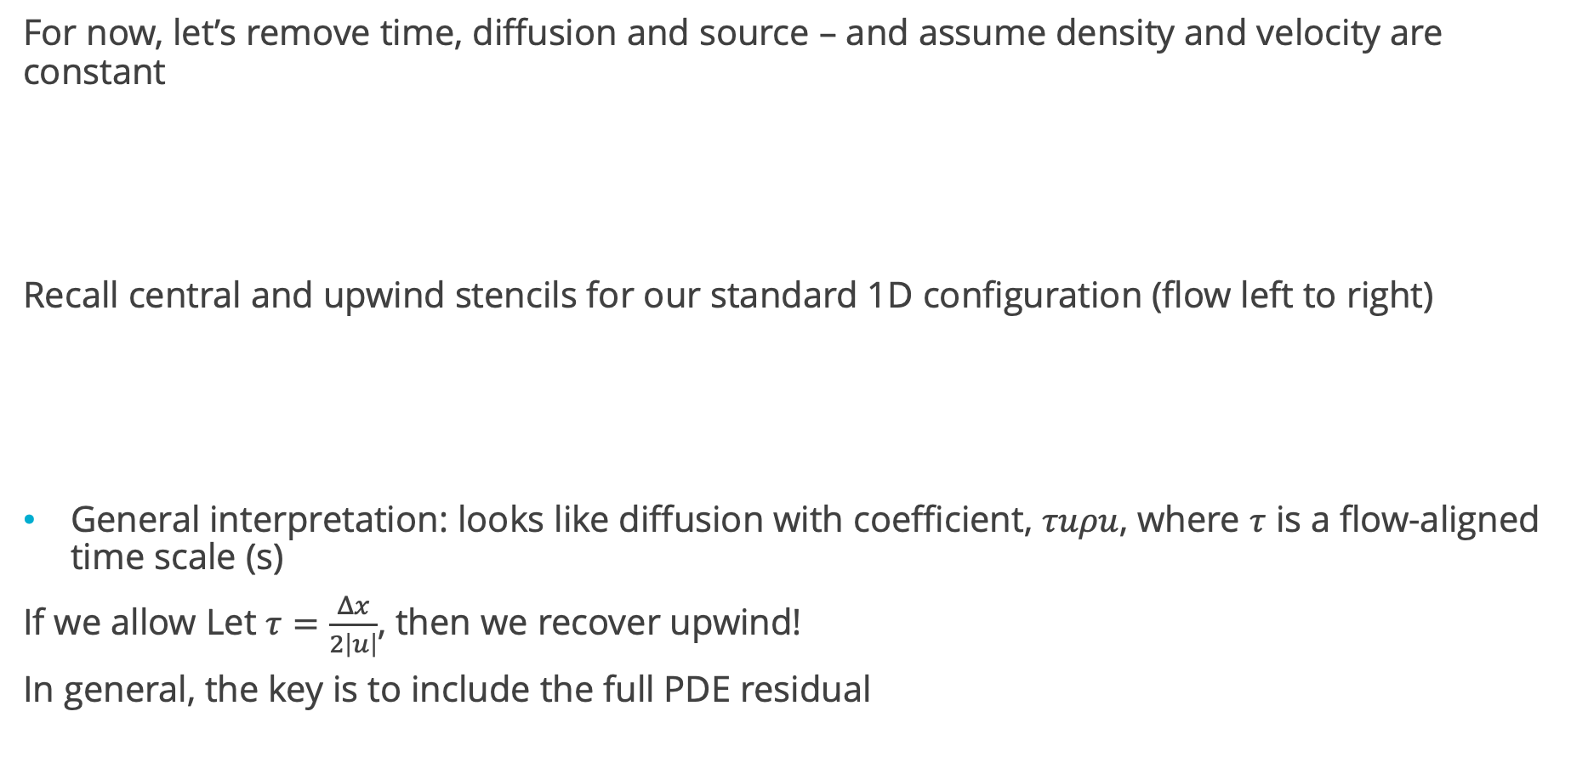
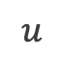
Linear Residual-Based Stabilization: CVFEM closer look
For now, let’s remove time, diffusion and source – and assume density and velocity are constant
Recall central and upwind stencils for our standard 1D configuration (flow left to right)
General interpretation: looks like diffusion with coefficient, $τuρu$, where $τ$ is a flow-aligned time scale (s)
If we allow Let $τ=\frac{Δx}{2\left|u\right|}$, then we recover upwind!
In general, the key is to include the full PDE residual
j-1
Z_{j-1/2}
j
Z_{j+1/2}
j+1
_{A}
$$u$$

Slide 11
Linear Residual-Based Stabilization: Consistency
The residual-based stabilization is given by,
with the fine-scale residual defined as,
Comments:
If the fine-scale residual is consistently evaluated, then as the mesh is refined the residual-based stabilization is removed
Recall that this is a linear stabilization scheme and may still admit oscillations
In the pure Finite Element Method description, this form of stabilization is a Petrov-Galerkin approach

Slide 12
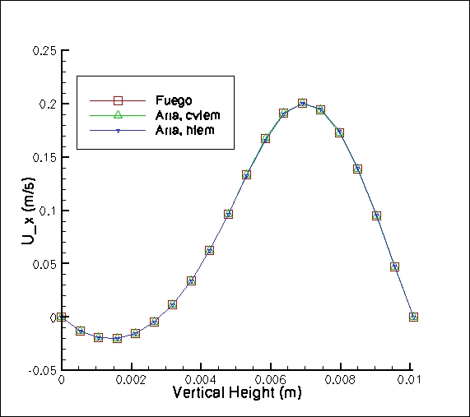
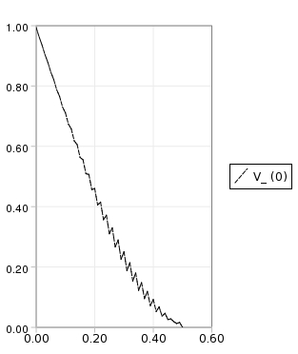
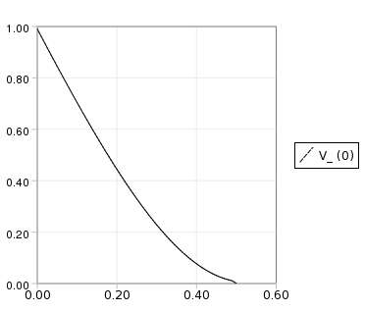
SUPG in Practice (CVFEM and FEM)
SUPG and the analog in CVFEM, Streamwise Upwind Control Volume (SUCV) are effective for low-moderate cell-Peclet numbers
Un-stabilized and SUPG
Convecting TV
SUPG/SUCV (Aria, hfem; Aria cvfem) back step
velocity prediction compared to upwind (Fuego)

Slide 13
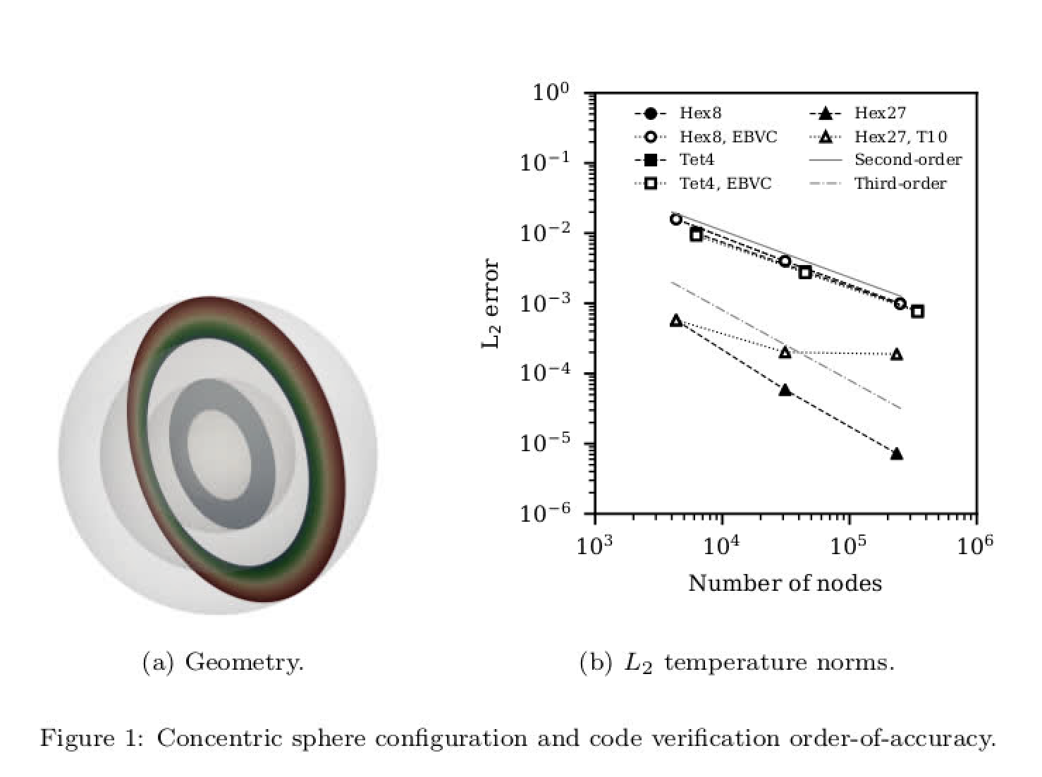
SUCV Generalized to Other Systems
Recall the radiative transport equation – derived in a variational multiscale (VMS) context, Domino et al., Phys. Fluids (2021)
α = β = 0, SUCV!

Slide 14
Nonlinear Stabilization Operator (NSO)
An artificial viscosity approach is provided with coefficient again related to a fine-scale residual, shown for both finite element and finite volume:
Here, we link the artificial diffusion coefficient to the fine scale residual:
Or min of::
Origin from FEM-based discontinuity capturing operator (DCO), Shakib et al. Comput. Method. Appl. Mech. Engr., (1991)
Similar concept to Guermond et al. “Entropy-viscosity” approach, J. Comp. Phys. (2011)
Variations form an interesting LES subgrid model when the viscosity is a function of the k.e. fine scale residual (Guermond and Larios, 2015)

Slide 15
Re = 2000 (local Re 20) – Residual-Based
Analytical solution from Mojtabi and Deville, One-dimensional linear advection–diffusion equation: Analytical and finite element solutions, Comput. Fluids 107 (2015) 189–195.
NSO, linear basis (CVFEM)
SUCV, linear basis (CVFEM)
NSO, quadratic basis (CVFEM)

Slide 16
Now, Direct Comparisons, Order of Accuracy
Convecting Taylor/Vortex simulation at high crossflow velocity
Results demonstrate the ability to deploy this stabilization approach to high-order

